Slide 2
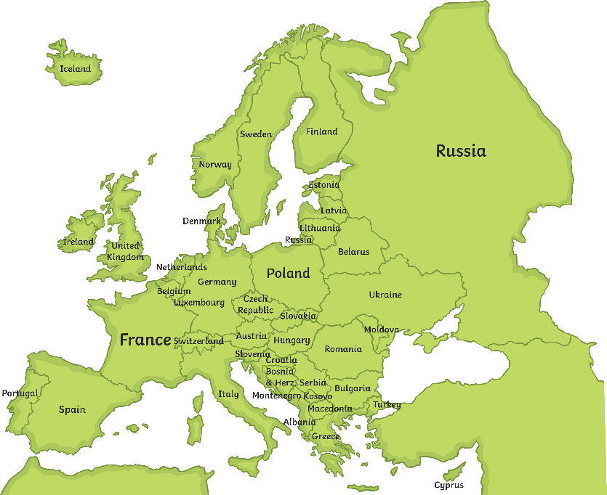
Before the War
Powerful European countries like Germany, Great Britain, and France were growing in wealth and power, taking control of smaller, weaker countries. This is known as imperialism.
What does the word imperialism mean?
Imperialism is the idea of taking over a nation and claiming it for your own.

Slide 3
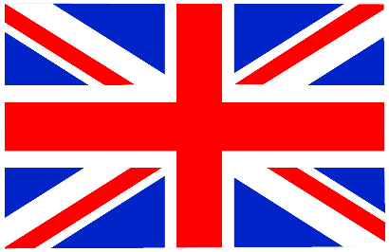
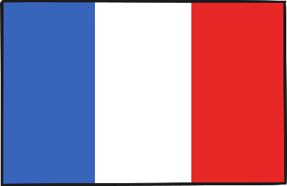
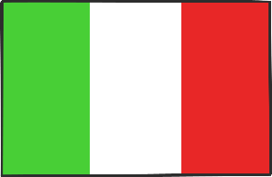
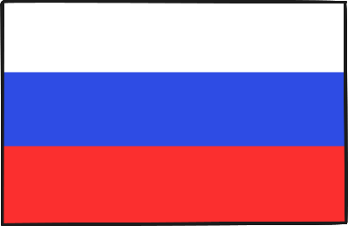
Alliances Between Countries
Many countries began to set up alliances with each other, even before the war. This meant that the countries would support one another and defend each other in case of war.
There were two main teams or alliances:
The Triple Entente (later known as the Allies):
Britain, France, and Russia
The Triple Alliance (later known as the Central Powers):
Germany, Italy, and Austria-Hungary

Slide 4
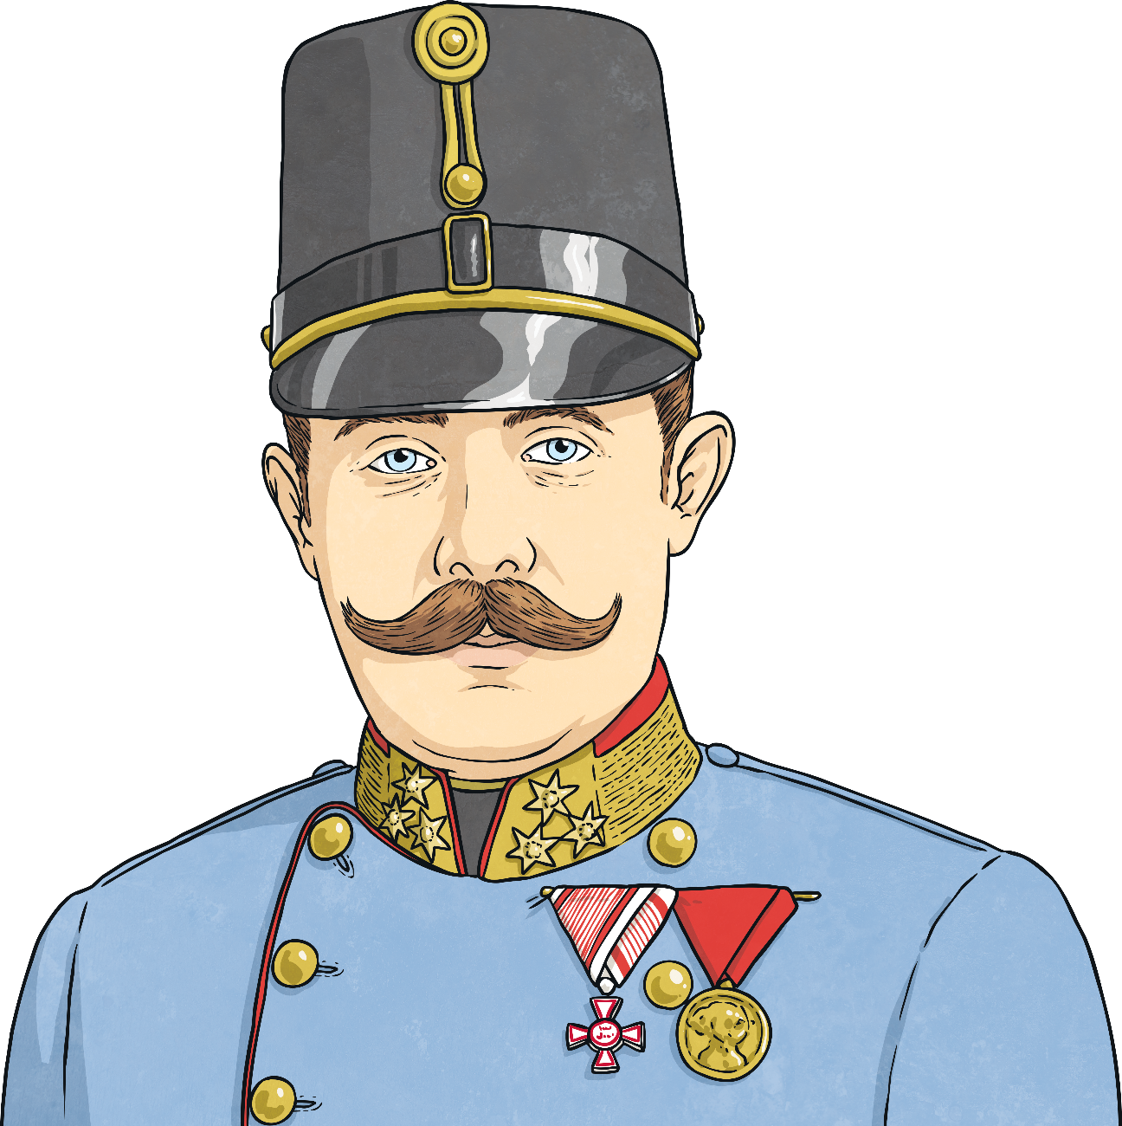
What Started World War I?
In 1914, Archduke Franz Ferdinand was to become the king of Austria-Hungary.
However, before he was able to take the
throne, he was assassinated by a
Serbian group called The Black Hand.
This event is seen as the main cause
of the World War I.

Slide 5
What Started World War I?
Archduke Franz Ferdinand
The archduke was visiting armies in Serbia in June 1914 when a member of The Black Hand,
named Gavrilo Princip, killed the archduke and
his wife during the visit.
Austria-Hungary blamed Serbia for the shooting
and declared war one month later.
Because of the already created alliances and the
promises to defend each other, much of Europe quickly entered what would become known as the Great War.

Slide 6
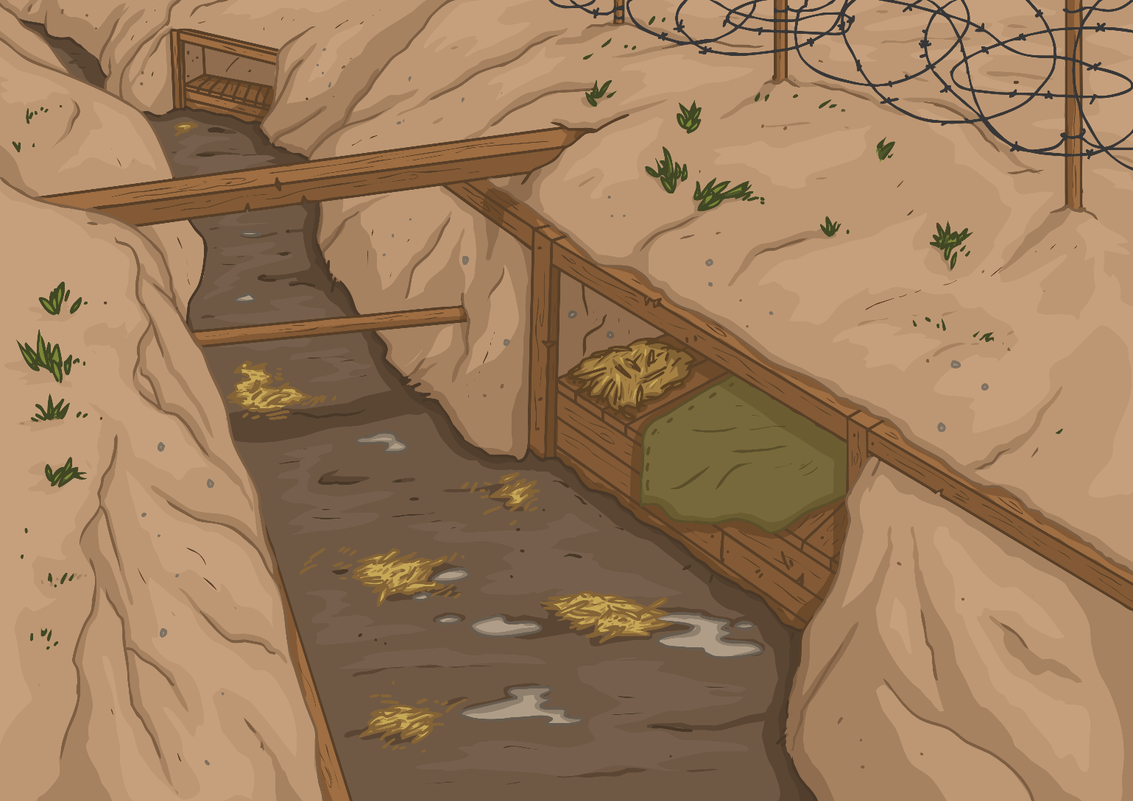
Archduke Franz Ferdinand
Trench Warfare
World War I was famous for trench warfare.
Trenches were dug into the land to protect the soldiers and make it more difficult for the opposing armies to attack.
At first, the trenches were dug in straight lines, with soldiers fighting alongside each other.
Eventually, trenches were dug with curves in them or at angles to better protect the soldiers.
The archduke was visiting armies in Serbia in June 1914 when a member of The Black Hand,
named Gavrilo Princip, killed the archduke and
his wife during the visit.
Austria-Hungary blamed Serbia for the shooting
and declared war one month later.
Because of the already created alliances and the
promises to defend each other, much of Europe quickly
entered what would become known as the Great War.

Slide 7
Life in the Trenches
The trenches usually had sandbags, wooden frames, and floorboards inside them.
Soldiers would create dugouts to sleep or rest when possible within the trenches.
Soldiers ate meals of canned meat, bread, and biscuits.
Later in the war, there were shortages of flour and meat, so pea soup was eaten along with a bread made from dried turnips.
Trenches were dirty, wet, and often filled with pests like rats and lice.
Life in the trenches was challenging, uncomfortable, and dangerous.

Slide 8
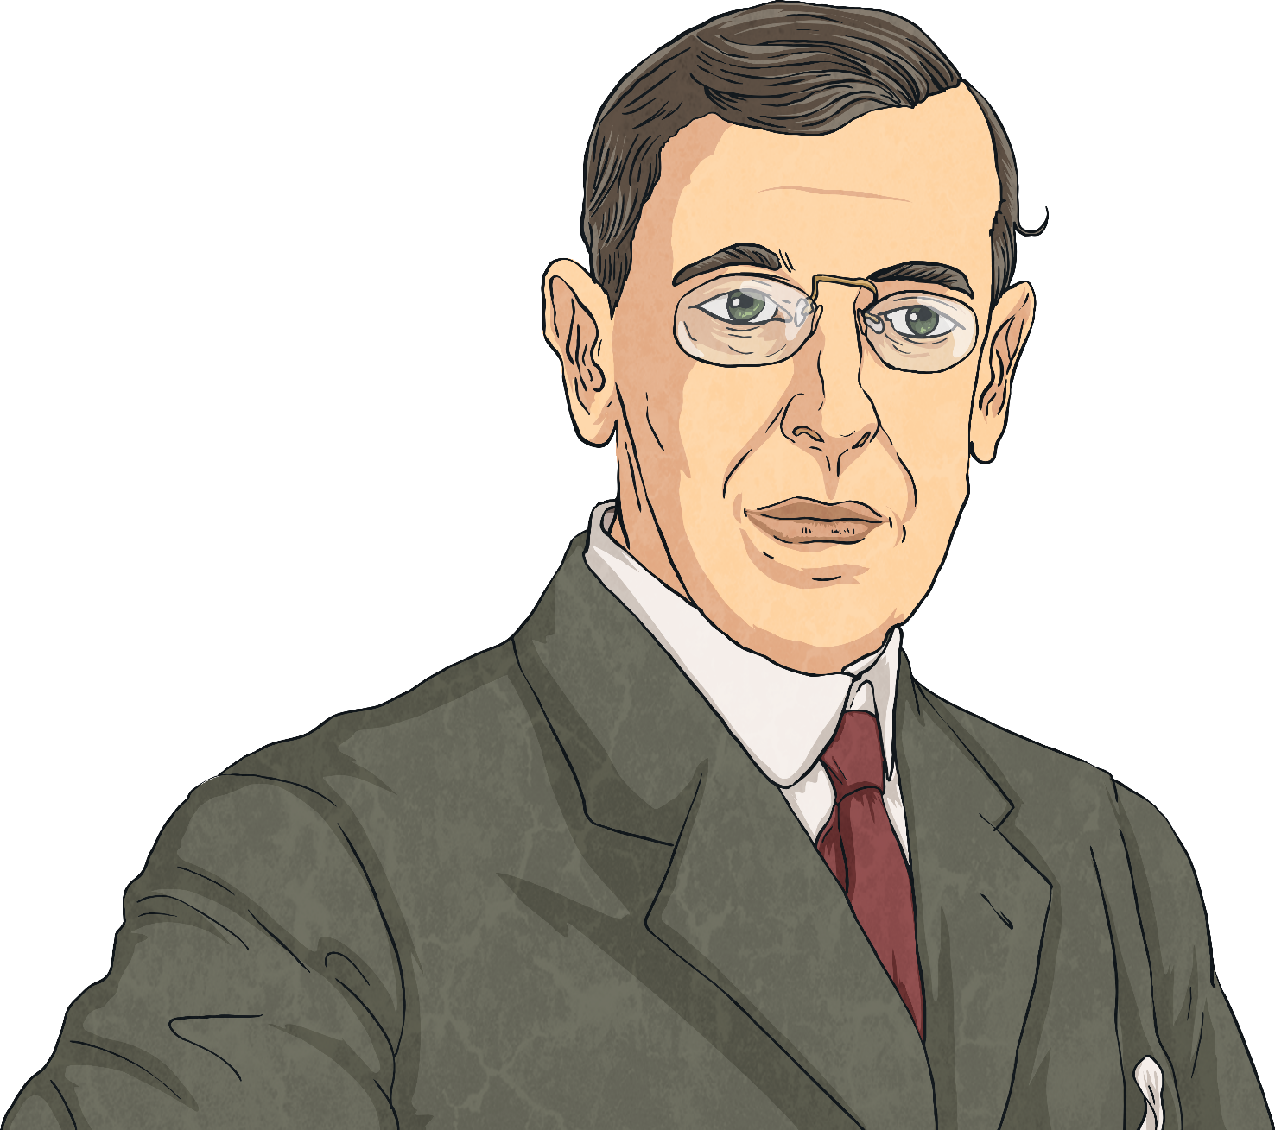
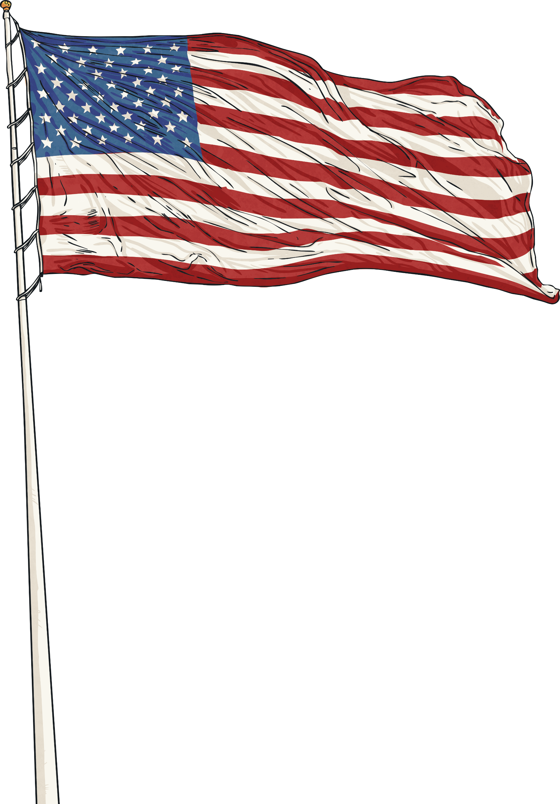
The United States
When the war first started in 1914, President Woodrow Wilson declared that the U.S. would remain neutral.
Most Americans supported this decision.
What does it mean for a country to remain neutral? Turn and share your thoughts with a partner. Be ready to share with the class!

Slide 9
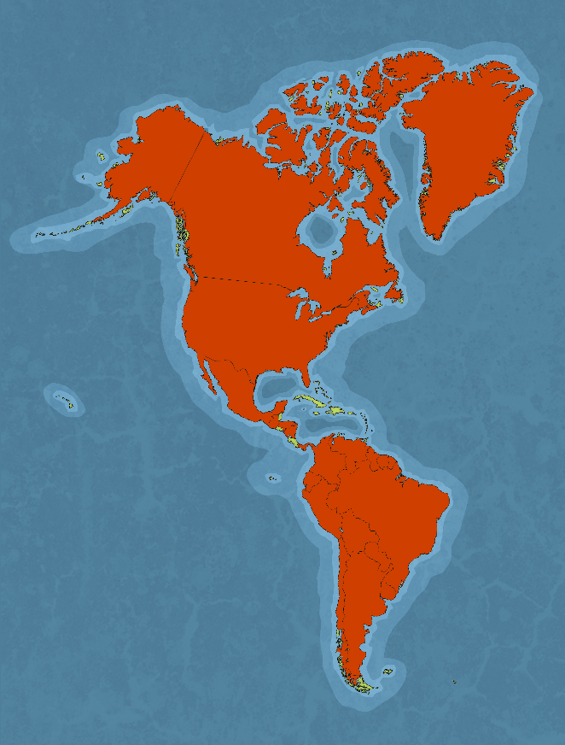
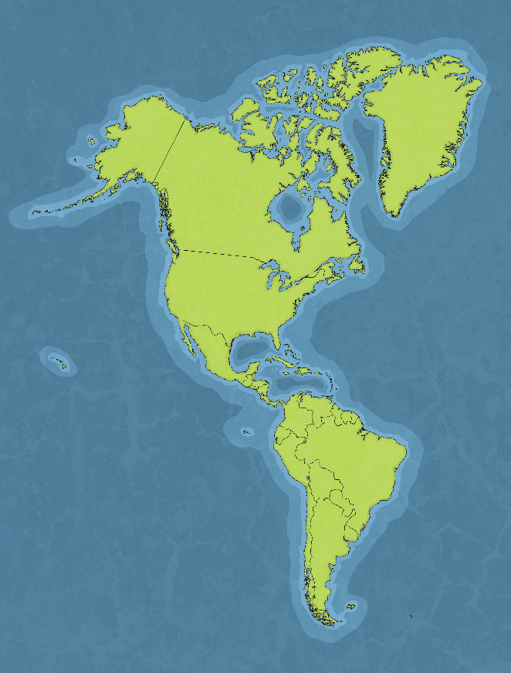
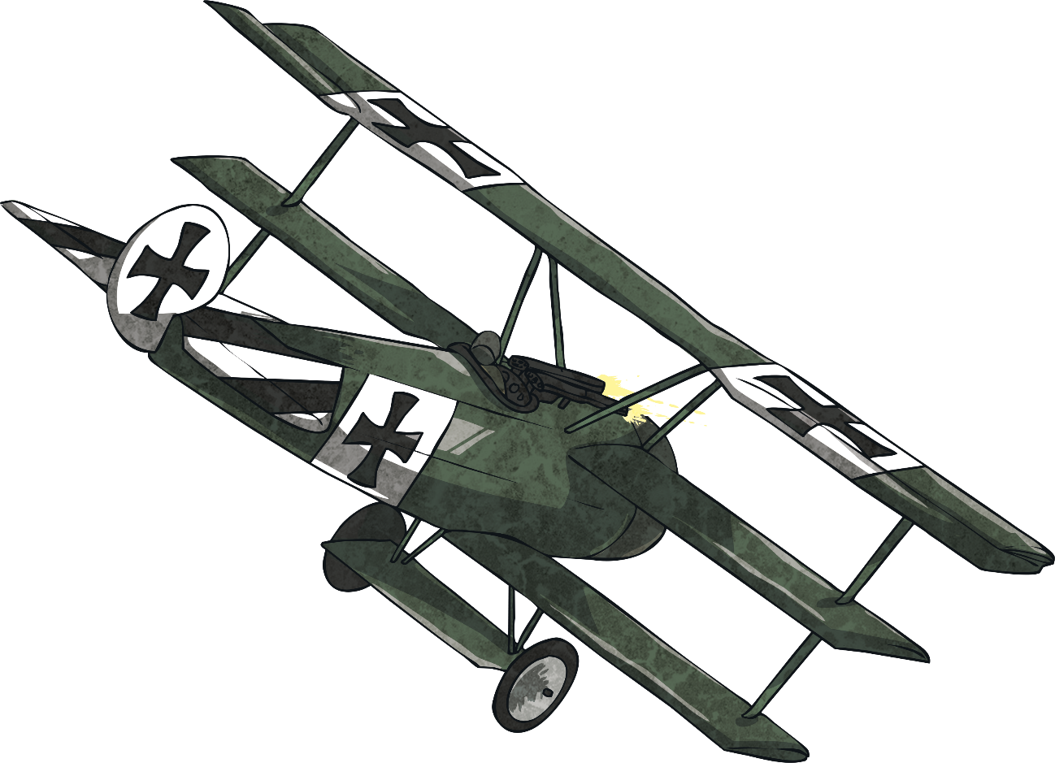
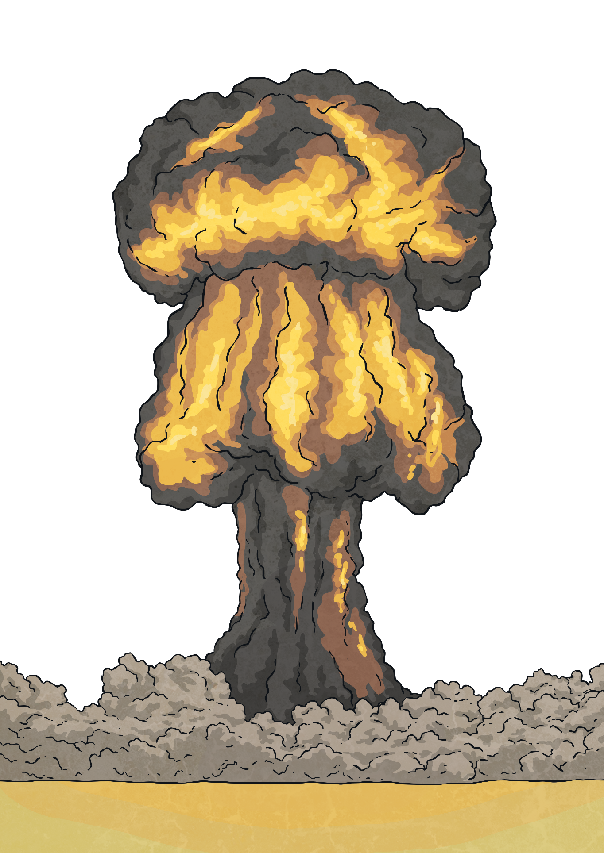
The United States
At that time of World War I, Britain was a major trading partner with the U.S.
Tensions began when Germany damaged and sunk several U.S. merchant (trading) ships around the waters of Britain.
In 1915, Germany announced unrestricted warfare against all ships in the war zone around Britain.
This meant that Germany would attack any ship coming into the area, whether the ship was from a neutral country or not.
When the war first started in 1914, President Woodrow Wilson declared that the U.S. would remain neutral.
Most Americans supported this decision.
What does it mean for a country to remain neutral? Turn and share your thoughts with a partner. Be ready to share with the class!

Slide 10
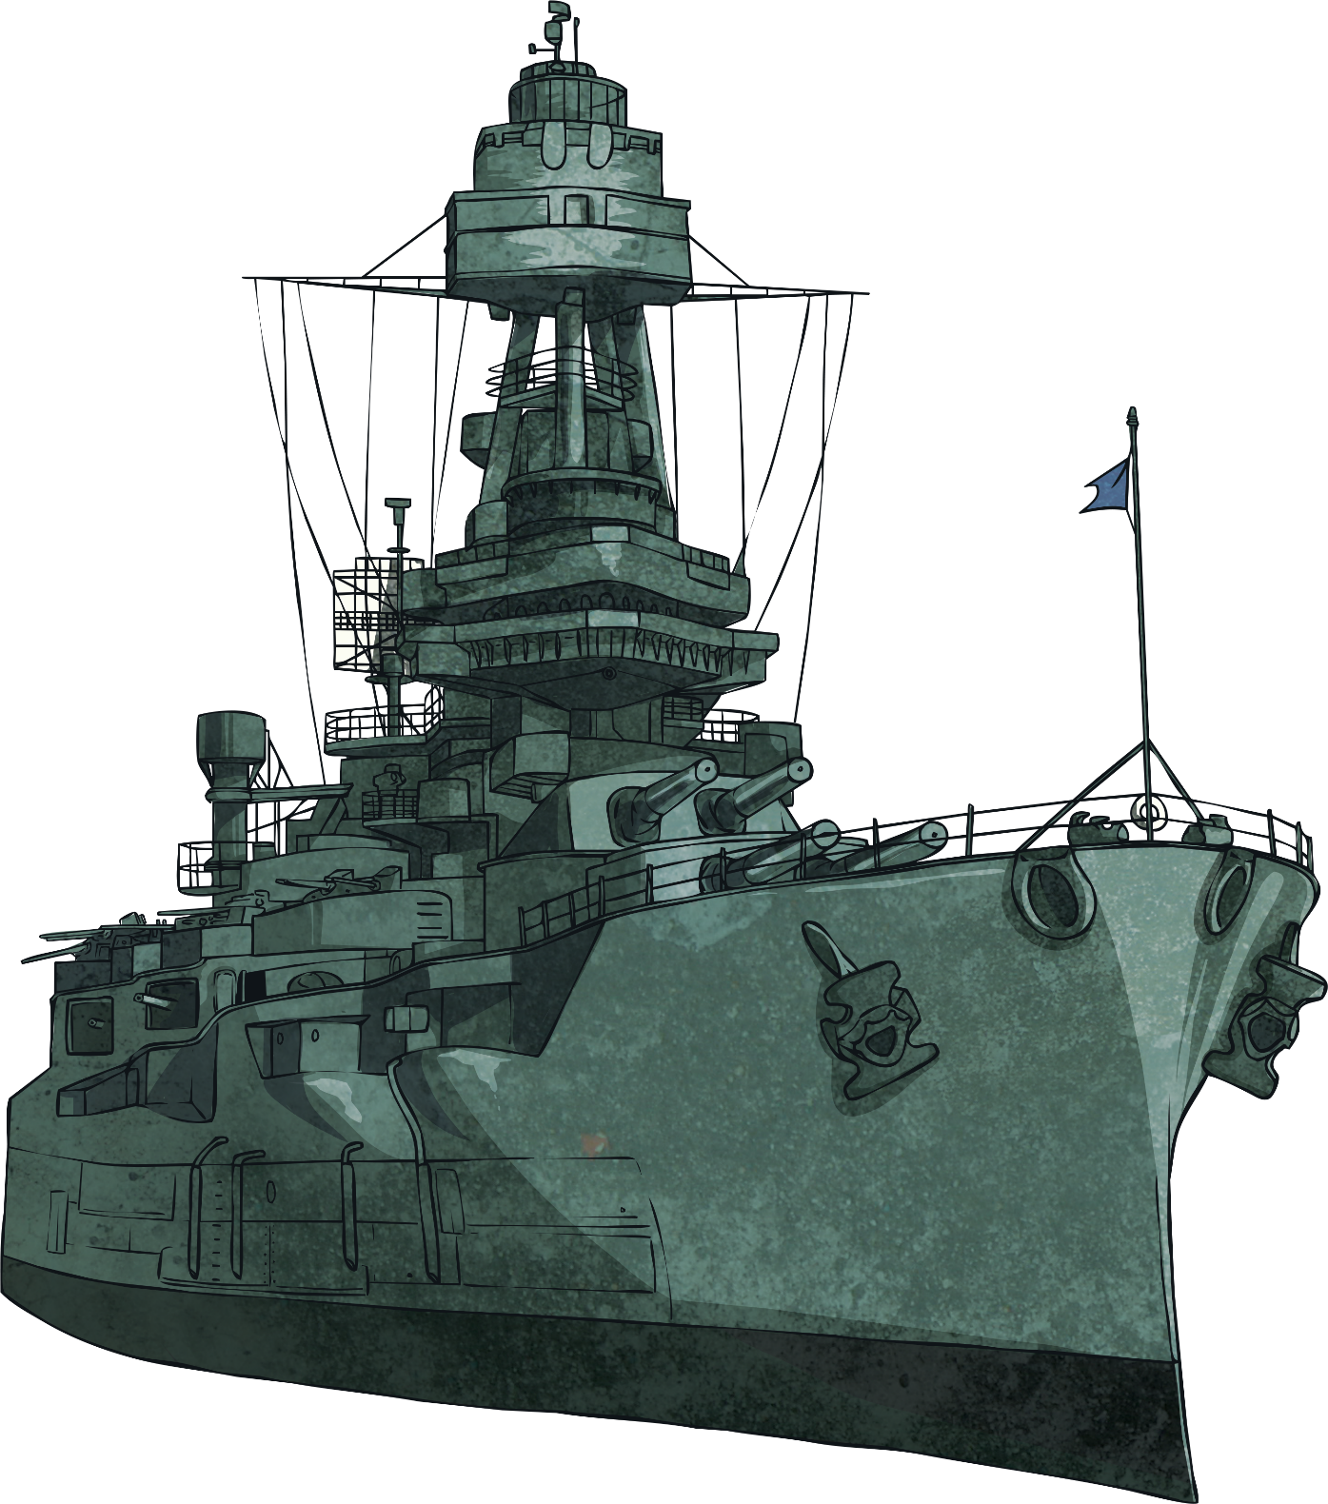
A New Allied Force
After two more years of damaged and sunken ships - both passenger and trading - American opinion began to change about staying neutral in the war.
On April 2, 1917, President Wilson went before Congress with a request to declare war against Germany.
His request was granted.

Slide 11
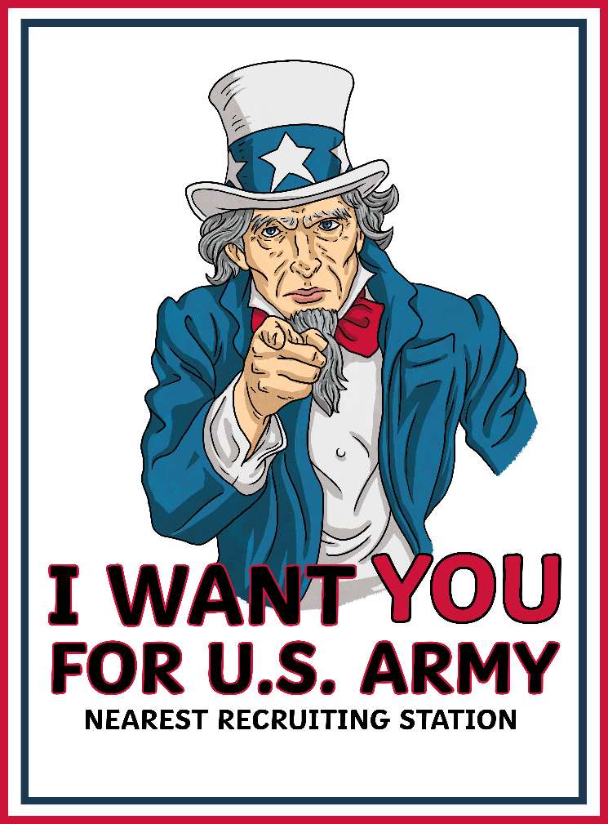
America Enters the War
By late June of 1917, more than 14,000 U.S. infantry troops arrived in France to begin training for the war.
The United States had joined together with Britain, France, and Russia in the Allied Forces.

Slide 12
Major Turning Point
America’s entrance into World War I proved to be a great turning point for the Allies.
With plenty of resources and well-supplied forces, the Allies became more victorious in their efforts against the Central Powers.
Fighting stopped on November 11, 1918, but the war officially ended with the signing of the Treaty of Versailles on June 28, 1919.
In just over a year and a half, two million Americans had served on the battlefields of Europe.
Close to 50,000 of them had lost their lives.

Slide 13
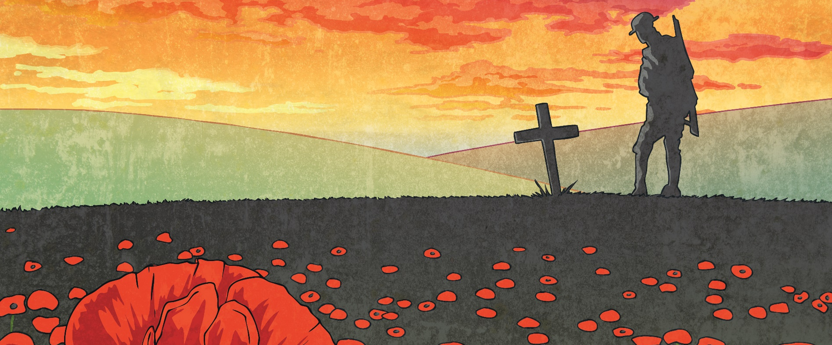
Armistice Day
After the war ended, President Woodrow Wilson declared November 11 to be Armistice Day. This day initially was to honor the end of World War I.
What does the word armistice mean?
An armistice is a temporary agreement between opposing sides in a war to stop fighting.

Slide 14
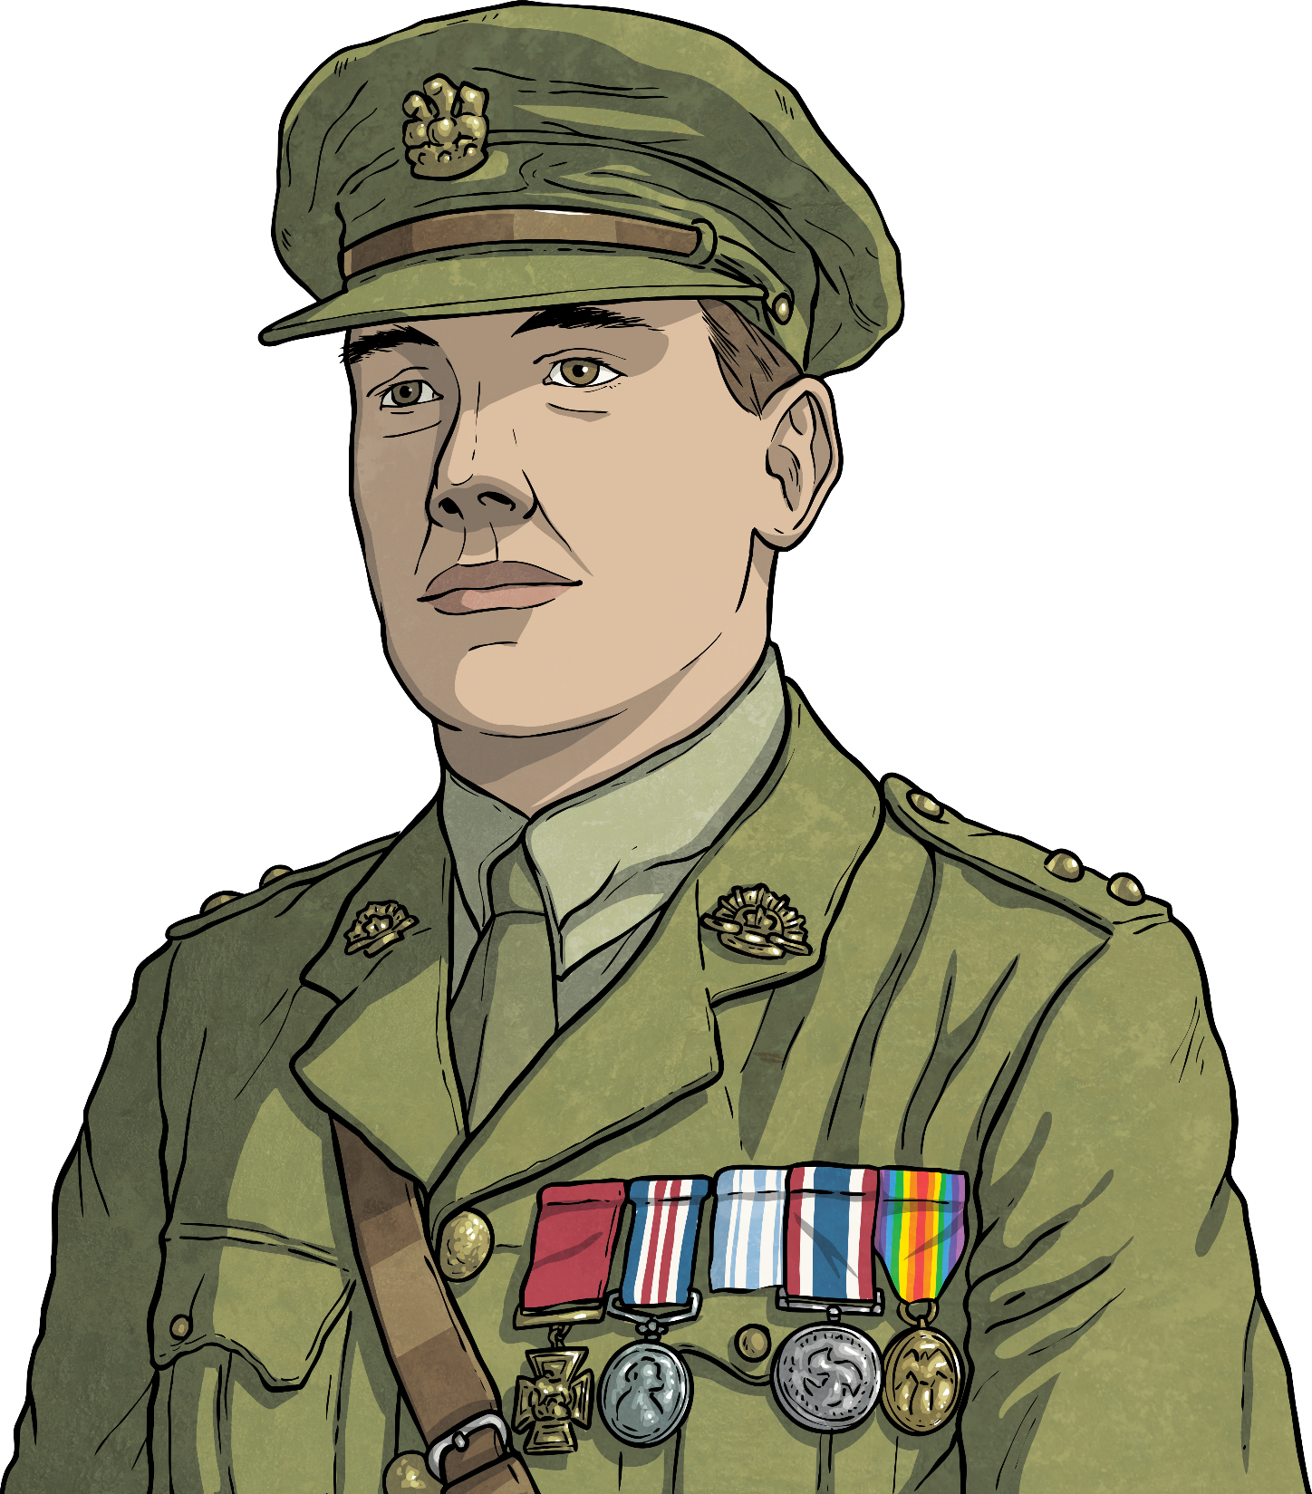
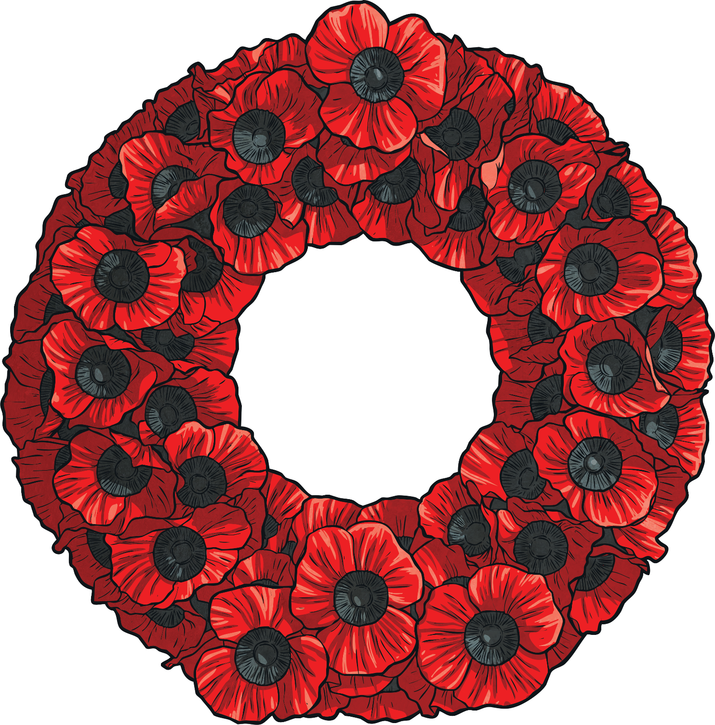
A Change to Veterans Day
In 1954, President Dwight Eisenhower officially changed the holiday’s name from Armistice Day to Veterans Day.
Veterans Day is still observed each year on November 11.
Veterans Day honors all people that have served in any war or conflict.

Slide 15
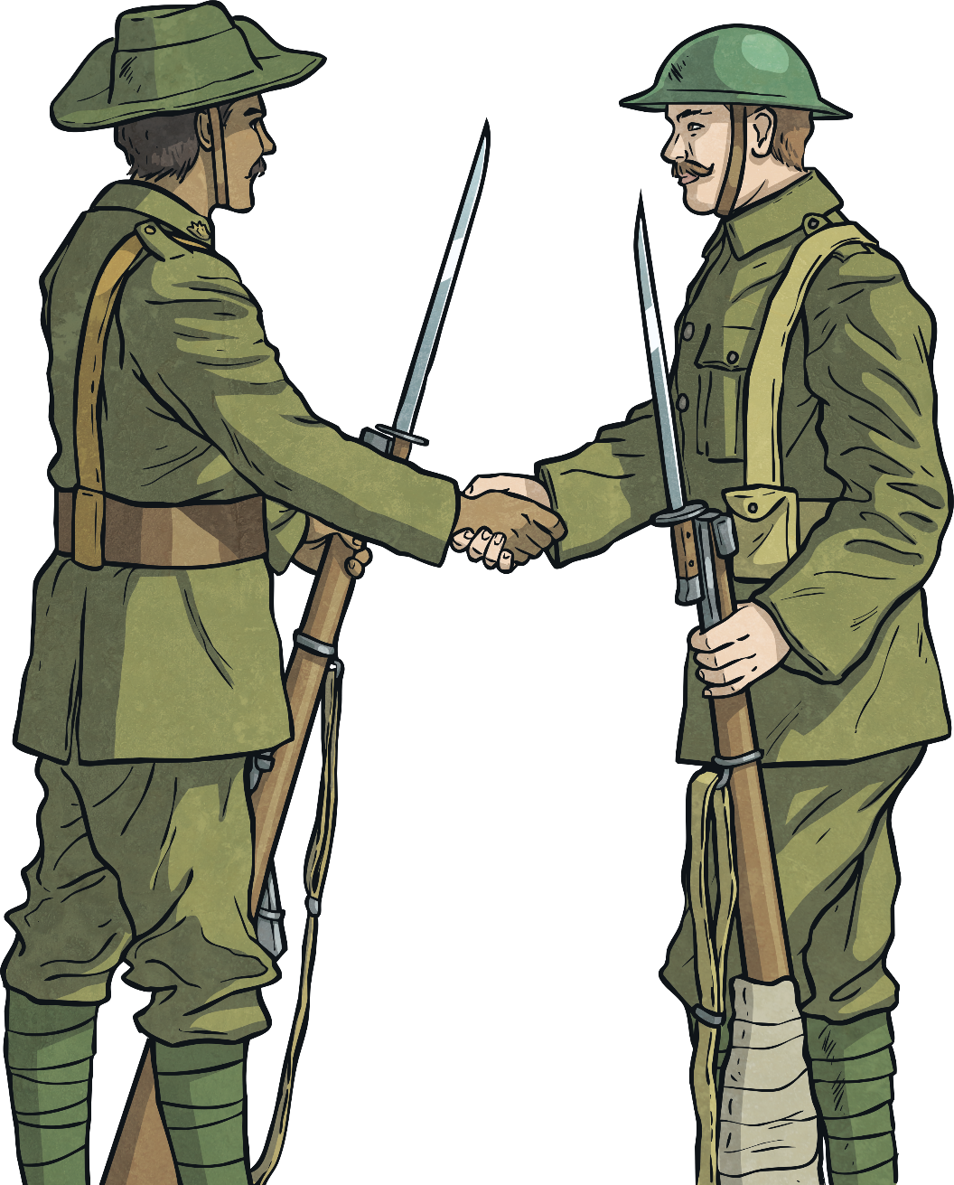
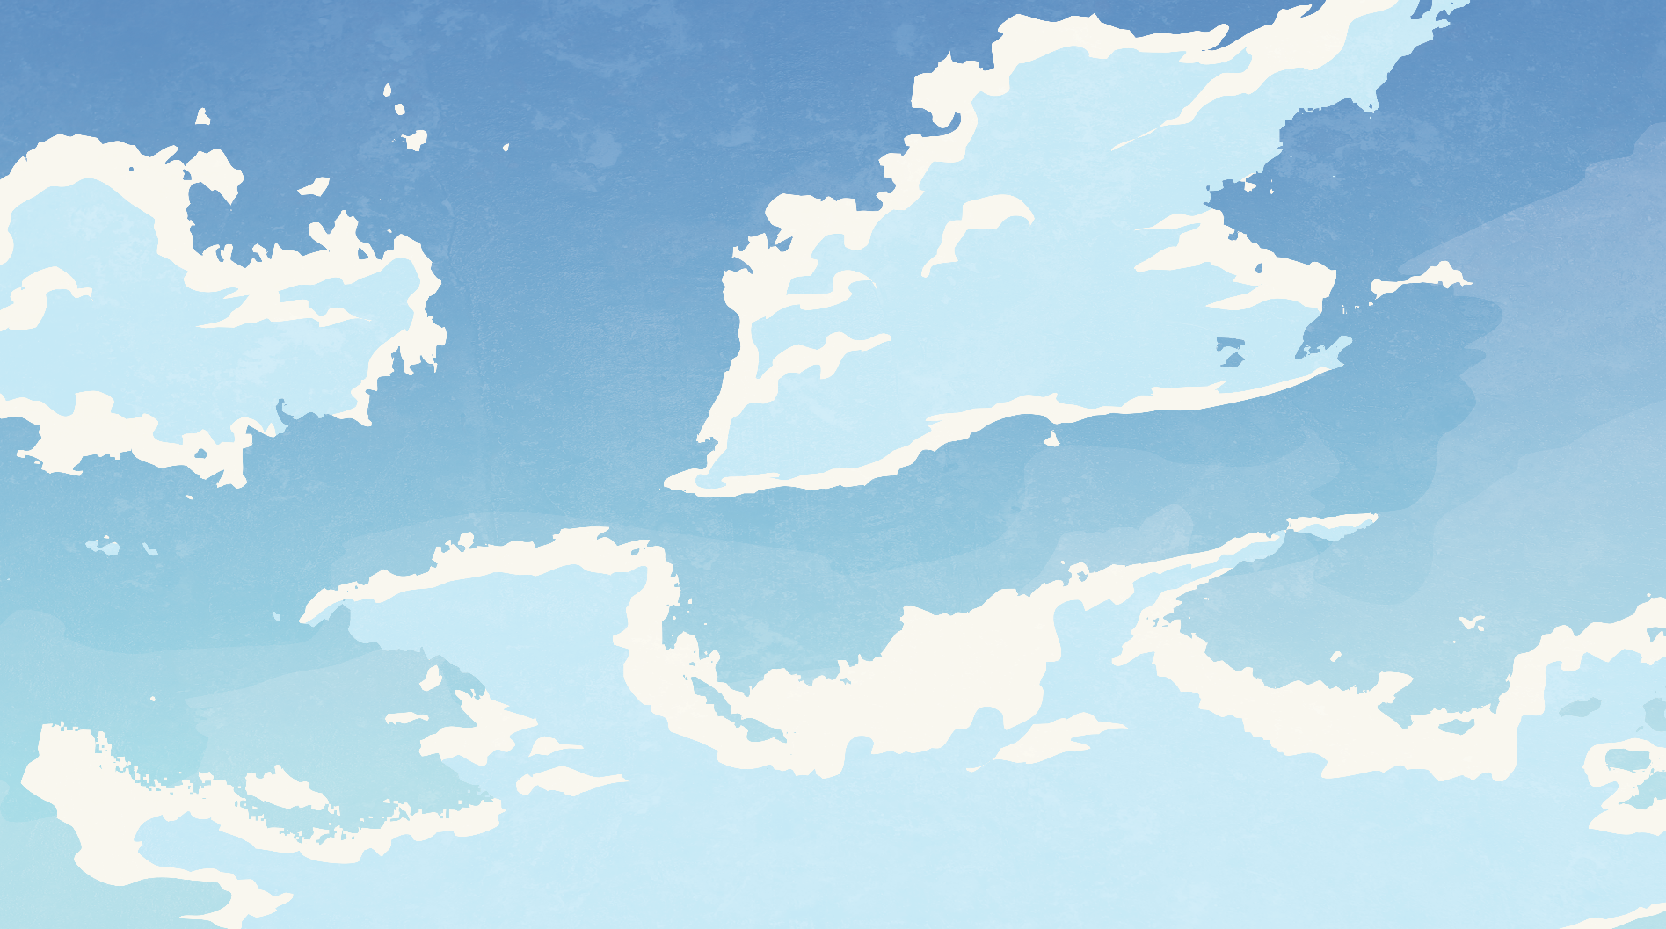
Think About It…
Why is it important to continue to learn about World War I?
Why should we celebrate and honor our veterans that have served in times of war?

