Slide 2
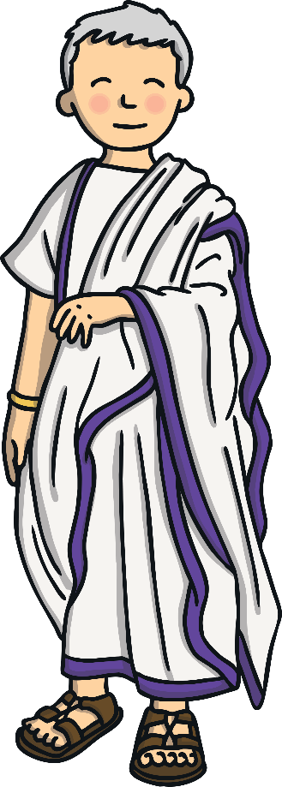
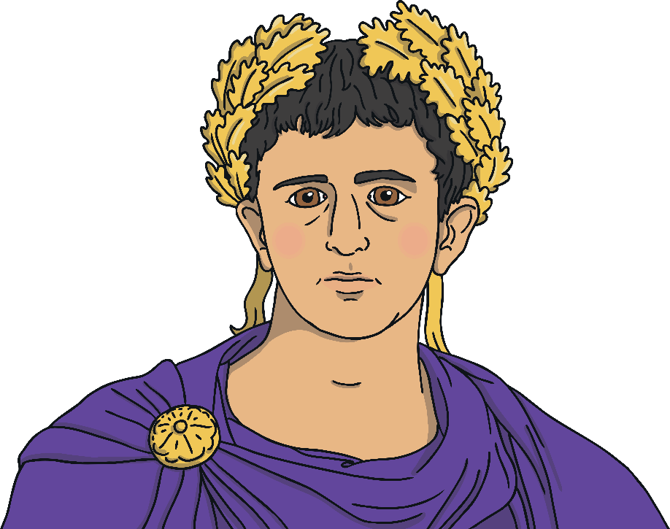
Valentine was a Roman priest who lived during the third century. At the time, Rome was ruled by an emperor called Claudius.
Valentine
Claudius

Slide 3
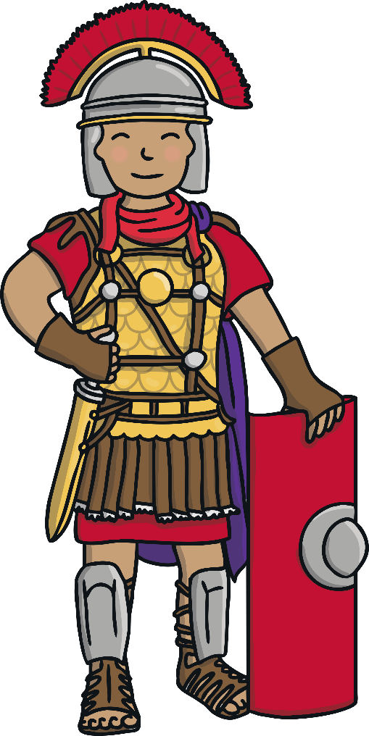
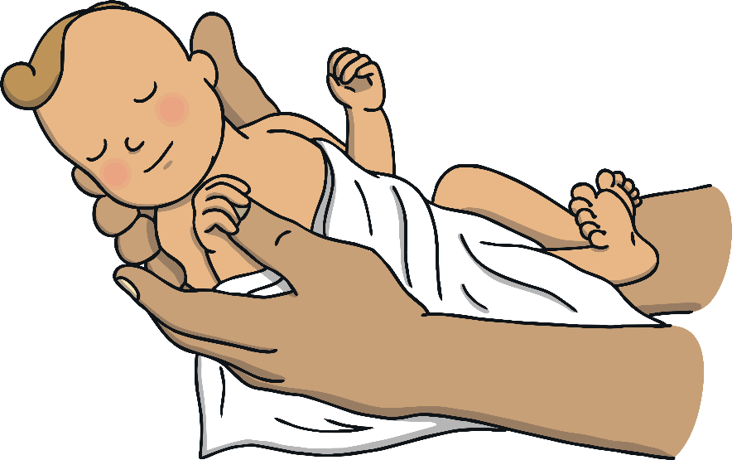
Claudius was angry because there weren’t enough Roman men becoming soldiers as nobody wanted to leave their wives and children to fight for him.

Slide 4

He forbade all men to marry so that they had no families or wives to use as an excuse for not wanting to join the army.
As Valentine was a priest, he helped the men by marrying them to their partners in secret.

Slide 5
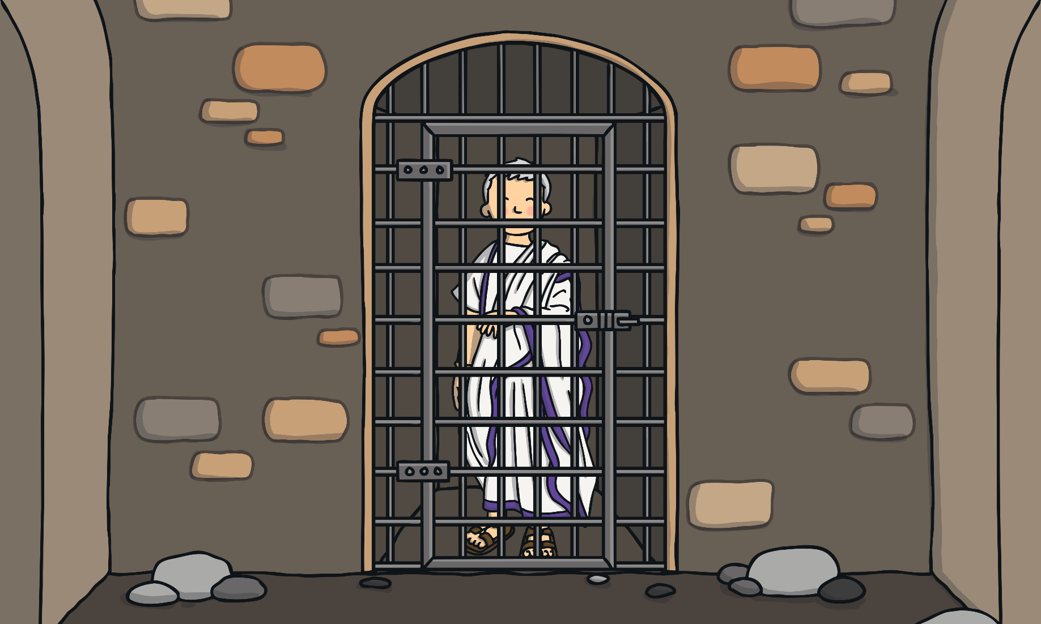
But Claudius soon found out about Valentine and ordered for him to be arrested and imprisoned.

Slide 6
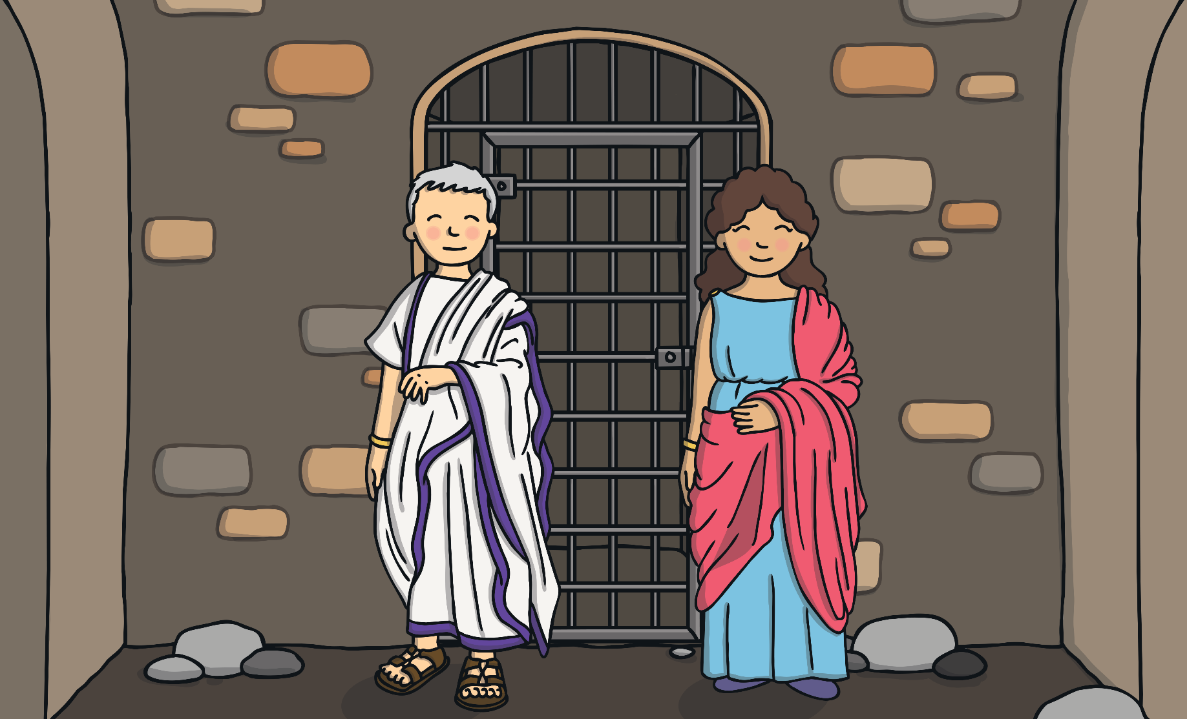
Whilst in jail, Valentine became a teacher to his jailer’s blind daughter, Julia.

Slide 7
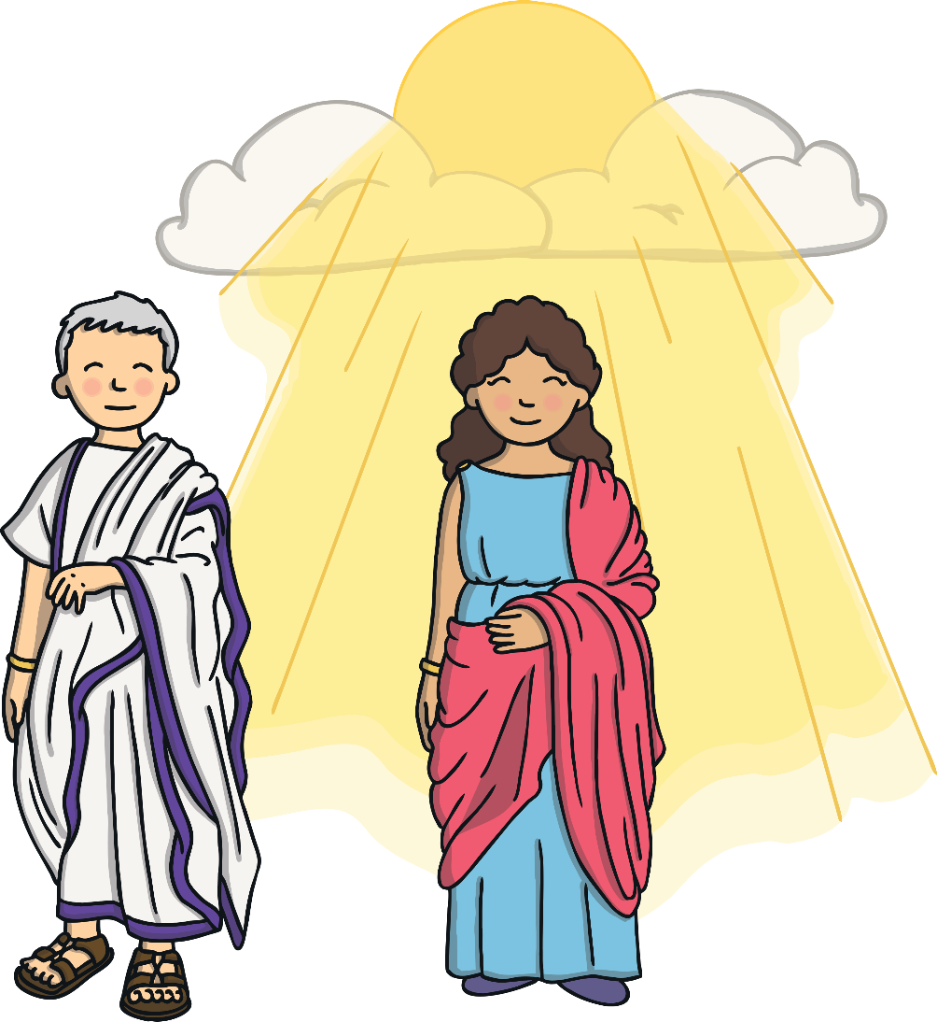
It is said that Valentine and Julia became great friends and that Valentine cured Julia’s blindness with a miracle!

Slide 8

On the day that Valentine died, he wrote Julia a goodbye letter and signed it from ‘your Valentine’.
He died on the 14th February.

Slide 9

Nowadays, we celebrate Valentine’s day by expressing our love for each other with cards, flowers, etc.
How will you celebrate it?

